Slide 1
Sentiment Analysis with BERT
Layer Freezing, Probability Calibration, and Ordinal Rating Mapping
Supervisor: Jesus Gonzalez

Slide 2
Team:
Bijay Bastakoti Binamra Aryal Navjot Gill

Slide 3
01
02
03
Intro/Data
Experiment
Post-Process

Slide 4
01
Intro/Data

Slide 5
Research Question
How do layer-freezing strategies and probability calibration affect classification performance and probability reliability for BERT-based sentiment models on the IMDB dataset, and how well can calibrated probabilities be mapped to ordinal star ratings?
Objectives/learning outcomes:
Understanding of Modern NLP Models
Practical Skills in Model Fine-Tuning
Proficiency in Evaluation Metrics

Slide 6
Research Papers
Kim, Y. (2014). Convolutional Neural Networks for Sentence Classification.
Devlin, J., et al. (2019). BERT: Pre-training of Deep Bidirectional Transformers for Language Understanding.
Pennington, J., Socher, R., & Manning, C. D. (2014). GloVe: Global Vectors for Word Representation.
Sun, C., et al. (2019). How to Fine-Tune BERT for Text Classification?
Guo, C., et al. (2017). On Calibration of Modern Neural Networks.

Slide 7

Experiment Overview
Main Question
Can we freeze BERT layers to reduce computation while keeping almost the similar performance?
Hypothesis
Freezing 8 encoder layers of BERT will still retain a high amount of the full fine-tuned F1 score.
High-Level Plan
Build a configuration-driven pipeline,
Train multiple CNN and BERT variants,
Evaluate them statistically over multiple runs

Slide 8
The IMDb Dataset: An Overview
The Stanford Large Movie Review Dataset, containing 50,000 labeled reviews.
Structure: The data is pre-organized into train and test sets , each with pos (positive) and neg (negative) subdirectories containing the raw text files
Labeling: Sentiment labels are derived directly from the folder structure (pos/neg). The filename convention, {id}_{rating}.txt, provides the original 1-10 star rating
Positive (Label 1): Star rating of 7 or higher.
Negative (Label 0): Star rating of 4 or lower.

Slide 9
Our Preprocessing Pipeline
Our workflow was designed for minimal but essential cleaning to preserve important linguistic signals for sentiment analysis. We explicitly avoided stop word removal and stemming/lemmatization.
No Stemming or Lemmatization. Different forms of words (e.g., "amazing" vs. "amazed") can carry nuanced sentiment. The models are expected to learn these representations from the data itself.
Preserve Sentiment-Rich Punctuation. Punctuation marks such as exclamation points (!) and question marks (?), as well as emoticons, were preserved as they are strong sentiment signals.

Slide 10
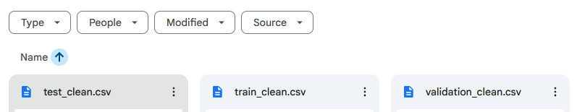
Data Partitioning
The original test set (25,000 reviews) was preserved as the final, held-out evaluation set to prevent data leakage
The original training set was split 90/10 to create:
A new training set of 22,500 reviews.
A validation set of 2,500 reviews for hyperparameter tuning.

Slide 11
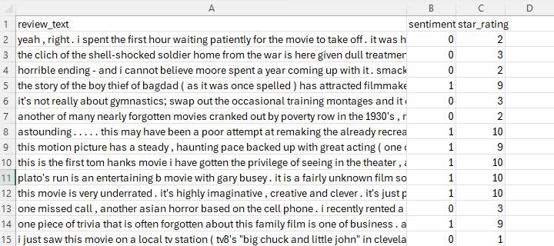
Final Output
The pipeline produces three clean, ready-to-use CSV files: train_clean.csv, validation_clean.csv, and test_clean.csv.

Slide 12
Preprocessing
Dual Tokenization Strategy: The project uses two distinct tokenization methods: a custom vocabulary is built from scratch for the Kim CNN model, while the pre-trained BERT model uses its own specific WordPiece tokenizer downloaded from Hugging Face.
Different Embedding Sources: The CNN model's vocabulary is mapped to pre-trained, 300-dimensional GloVe embeddings, which are loaded from a separate file. In contrast, the BERT model uses its own contextual embeddings that are an inseparable part of the pre-trained bert-base-uncased model.
Maximum sequence length = 512 tokens:
Covers ~90% of reviews.
Consistency
Same cleaned text and same max_length used for all models
→ differences in performance are due to architecture, not preprocessing.

Slide 13
02
Experiments

Slide 14
Research Question 1
Can we freeze multiple lower layers of a BERT model for IMDb sentiment analysis and still retain at least 98% of the full fine-tuned performance, while reducing the number of trainable parameters and training time?

Slide 15
Project Structure & Pipeline
Single Entry Point
All experiments run via run_experiment.py.
Config-Driven Design
Model, optimizer, layer-freezing, and training options are defined in YAML config files.
New experiments = change config file, not core code.
Shared Dataset Class
Custom PyTorch SentimentDataset:
Handles tokenization for both CNN and BERT.
Keeps the data pipeline consistent across all models.

Slide 16
Experimental Environment
Hardware & Platform
All experiments run on Google Colab.
GPU: NVIDIA T4.
Frameworks
PyTorch for model implementation and training.
HuggingFace Transformers for bert-base-uncased.
Reproducibility Details
Data loading, training loops, and evaluation integrated into the same pipeline.
Model and run configurations tracked via YAML files and seed settings.

Slide 17
CNN Baseline Configuration
Architecture
Convolutional Neural Network based on Kim (2014).
Embeddings
Pretrained GloVe 6B, 300-dimensional (glove.6B.300d.txt).
Training Setup
Optimizer: Adadelta.
Batch size: 50 (as in Kim’s setup).
Two CNN Variants
Static CNN
GloVe embedding layer frozen.
~360,902 trainable parameters.
Non-static CNN
GloVe embedding layer fine-tuned.
~36,940,502 trainable parameters.

Slide 18
BERT Configurations & Layer Freezing
Base Model
bert-base-uncased (Devlin et al., 2019)
~109M total parameters
Training Hyperparameters
Batch size: 16
Learning rate: 2 × 10⁻⁵
4 epochs for all BERT runs
Layer-Freezing Variants
Full fine-tuning: all 12 encoder layers trainable (~109M params)
Freeze 4 layers: first 4 encoder layers frozen (~57.3M trainable params)
Freeze 8 layers: first 8 encoder layers frozen (~28.9M trainable params)
Freeze 11 layers: all but the last encoder layer frozen (~7.7M trainable params)
Goal
Measure the performance vs efficiency trade-off across these configurations

Slide 19
Evaluation Protocol & Metrics
Validation Strategy
Each model configuration trained 3 times with different seeds: 42, 123, 2025
Total of 18 runs across CNN and BERT setups
Reported Metrics
Test Accuracy (overall correctness)
F1 Score (balance between precision and recall)
For each setting: mean ± standard deviation over 3 runs

Slide 20
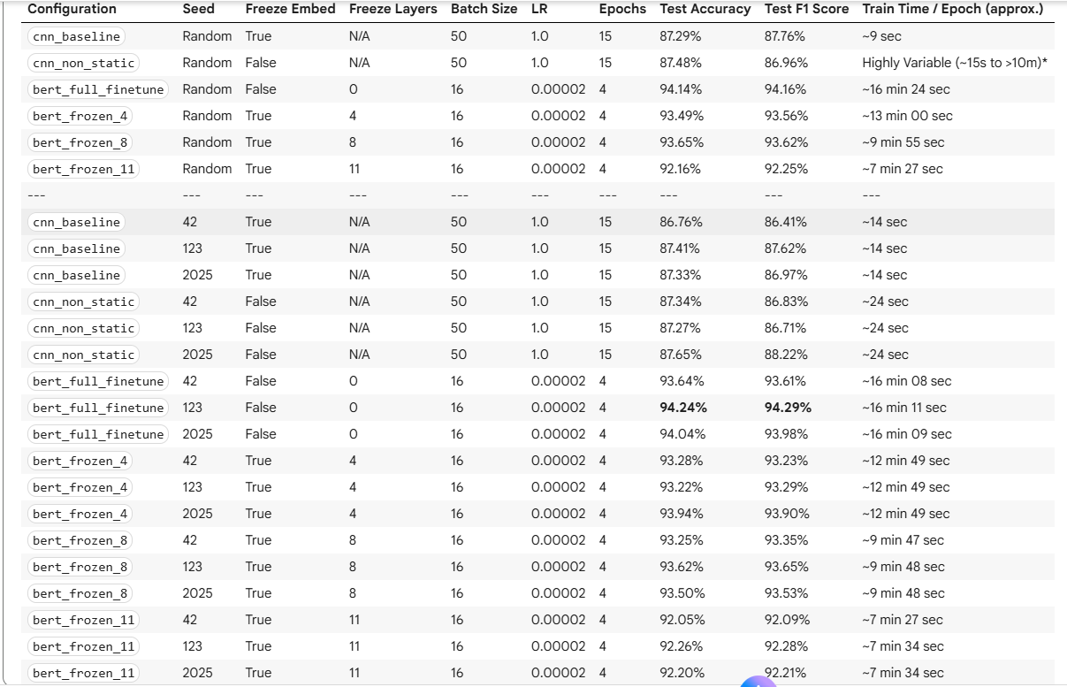
Table 1: Final test results + approximate training time per epoch across all models

Slide 21
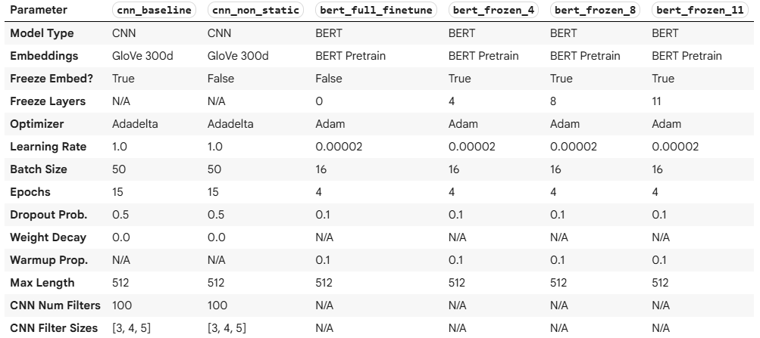
Table 2: Hyperparameter comparison

Slide 22
Analysis of our Research Question
Freezing 8 BERT layers preserved ~99.5% of the full fine-tuned F1 score while significantly reducing trainable parameters and training time, confirming that substantial layer freezing is possible without meaningful loss in IMDb sentiment performance.

Slide 23
03
Post-Process

Slide 24
Three Stages:
Probability Generation
Probability Calibration
Ordinal Rating Mapping
1
2
3
Generate the confidence score
Calibrate the confidence score
Map the calibrated score ordinally

Slide 25
Research Question 2
Is our model's confidence reliable, and can we improve its 'honesty'?

Slide 26
1 Probability Generation
Goals: Capturing the Model's "Uncalibrated" Confidence Scores.
Loaded our "champion" BERT model (...seed123.pt).
Ran "forward pass" (inference) on all 27,500 samples.
Used Softmax function to convert logits into probabilities.
Saved outputs (probs, labels, ratings) to .npz files.
Result: Created the crucial "Before" snapshot of our data.

Slide 27
1 Probability Calibration
Goal: Measure our model's "trust gap" and create a "correction function" to fix it.
Measured baseline ECE & Brier scores on the raw test data.
Fitted an Isotonic Regression model on the validation set to learn a "correction function.
Applied this correction to the test set to get new "honest" probabilities.
Result: Table on the next slide

Slide 28
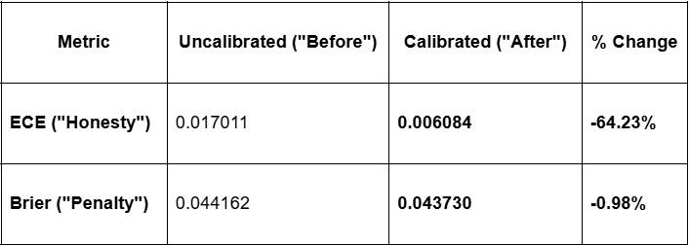
2 Probability Calibration

Slide 29
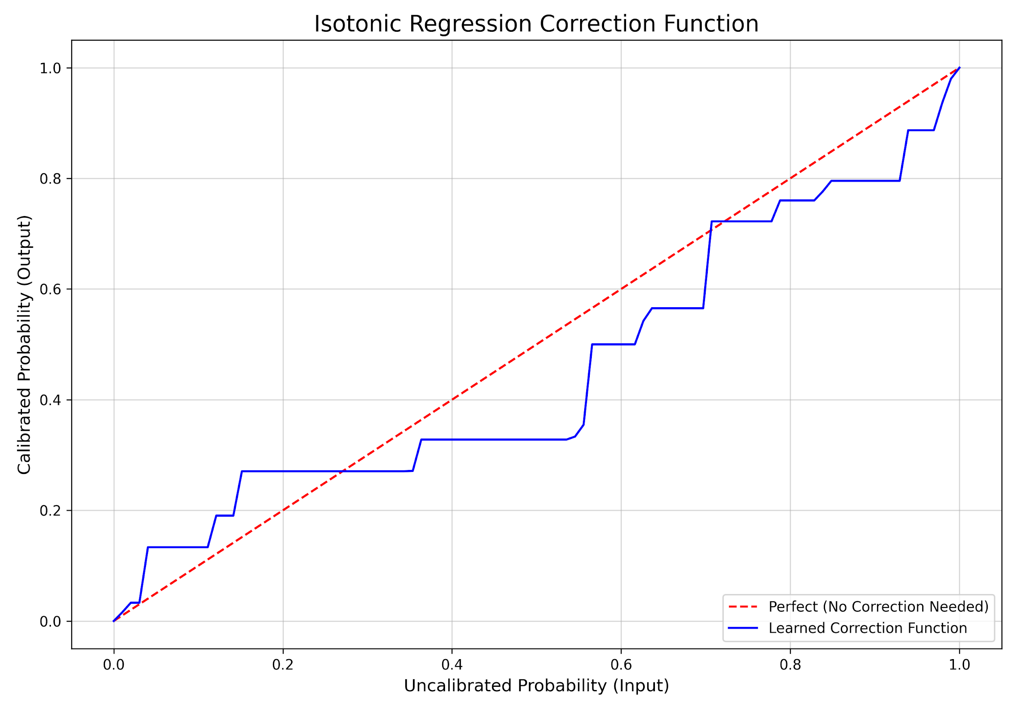
2 Probability Calibration

Slide 30
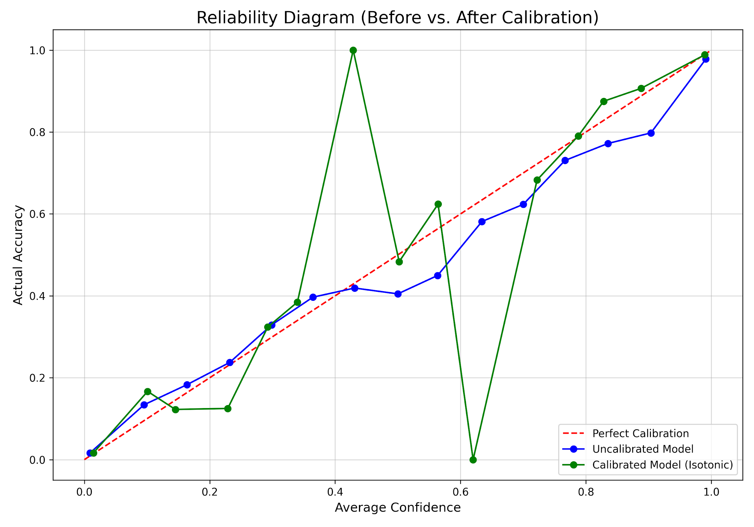
2 Probability Calibration

Slide 31
Answer to RQ 2
We proved the model's confidence was unreliable but also fixable.

Slide 32
Research Question 3
Can our new 'honest' probability score predict how positive a review is (from 1-5 stars)?

Slide 33
3 Ordinal Rating Mapping
Goals: To prove that our "honest" calibrated probabilities are a superior predictor of nuanced star ratings (1-5 scale).
Solved the "Gap Problem" by mapping the gappy 1-10 star ratings to a 1-5 scale
Mapped both uncalibrated and calibrated probabilities to the same 1-5 scale using the formula 1 + (prob * 4)
Compared both prediction sets against the "Ground Truth" using four new metrics: MAE, RMSE, Pearson, & Spearman.
Result:Table on the next slide

Slide 34
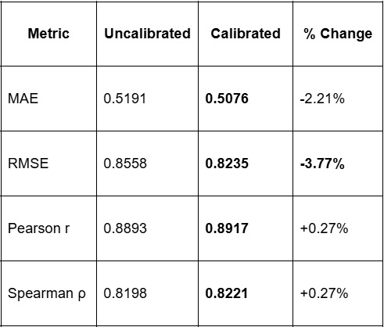
3 Ordinal Rating Mapping

Slide 35
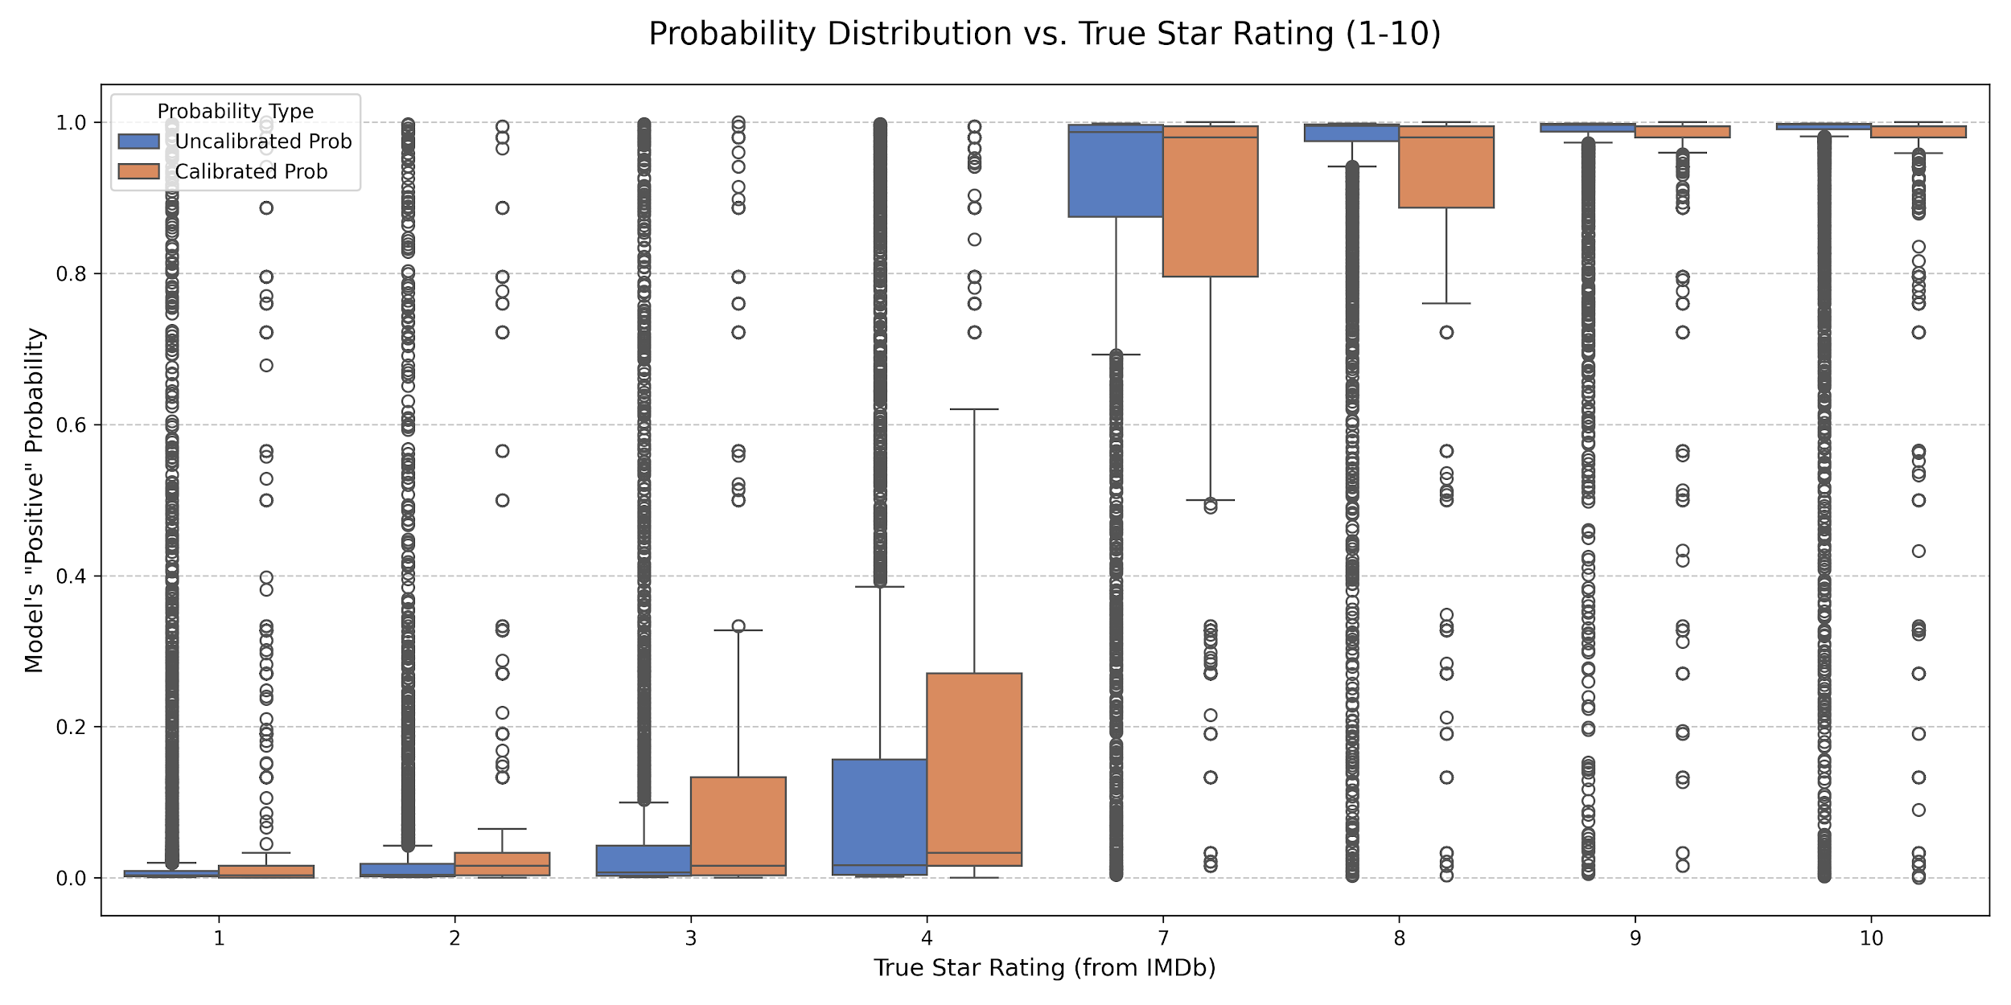
3 Ordinal Rating Mapping

Slide 36
Answer to RQ 3
A more "honest" model is also a more "nuanced" model.

Slide 37
Thank You

